Slide 1

Dr. Sajid Iqbal
Department of Computer Science
Bahauddin Zakariya University, Multan

Slide 2

INTRODUCTION TO Machine Learning 3rd Edition
ETHEM ALPAYDIN
© The MIT Press, 2014
alpaydin@boun.edu.tr
http://www.cmpe.boun.edu.tr/~ethem/i2ml3e

Slide 3
4.6 Regression

Slide 4
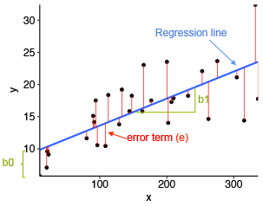

Regression
In regression, using independent variable, numeric output is calculated
The numeric output is the sum of a deterministic function of the input and random noise
$r=f\left(x\right)+ε$ where
$f(x)$: is the unknown function, which we would like to approximate by our estimator
$ε$:random noise is zero mean Gaussian with constant variance
$σ^{2}$ $ε∼ N(0, σ^{2})$
$g(x|θ)$: defined up to a set of parameters θ
Putting g(x) for f(x)
$p(r|x)∼N(g(x|θ), σ^{2})$

Slide 5
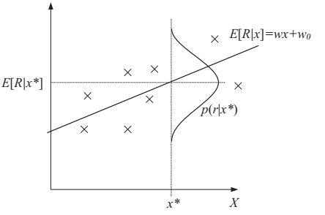
Regression
Regression assumes 0 mean Gaussian noise added to the model; here, the model is linear

Slide 6
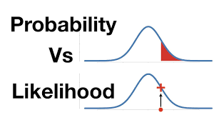
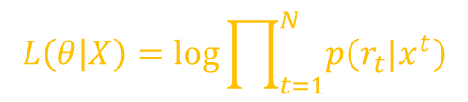

Regression
Let input instances are drawn from some unknown distribution p(x,r)
$p(x, r)=p(r|x)p(x)$
$p\left(r | x\right):$is the probability (likelihood) of the output given the input
$p\left(x\right):$ is the input density (prior)
The log likelihood (if all examples are iid)
$L\left(θ | X\right)=\log{\prod_{t=1}^{N}{p(x^{t}, r^{t})}}$
$L\left(θ | X\right)=\log{\prod_{t=1}^{N}{p\left({r_{t}|x}^{t}\right)+}}\log{\prod_{t=1}^{N}{p\left(x^{t}\right)}}$
Term one depends upon estimation of $r^{t}$ so we keep it
Second term does not depend, hence we can ignore it
$$L\left(θ | X\right)=\log{\prod_{t=1}^{N}{p\left({r_{t}|x}^{t}\right)}}$$

Slide 7
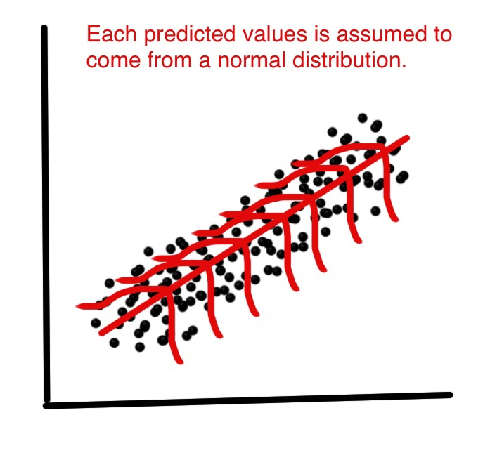

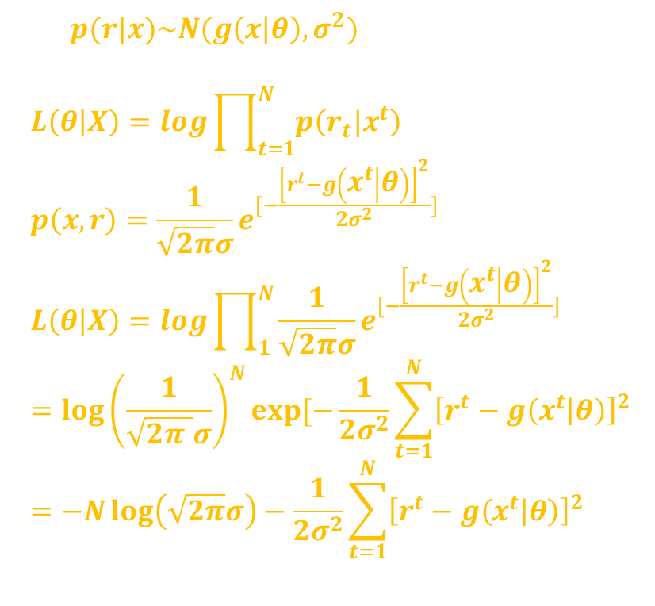
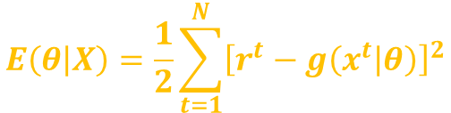
Regression for normally distributed data
Let $p(r|x)\sim N(g\left(x | θ\right),σ^{2})$ then
$$L\left(θ | X\right)=\log{\prod_{t=1}^{N}{p\left({r_{t}|x}^{t}\right)}} \\ p\left(x,r\right)=\frac{1}{\sqrt{2π}σ}e^{[−\frac{{\left[r^{t}−g\left(x^{t} | θ\right)\right]}^{2}}{2σ^{2}}]} \\ L\left(θ | X\right)=\log{\prod_{1}^{N}{\frac{1}{\sqrt{2π}σ}e^{[−\frac{{\left[r^{t}−g\left(x^{t} | θ\right)\right]}^{2}}{2σ^{2}}]}}} \\ ={\log\left(\frac{1}{\sqrt{2π }σ}\right)}^{N}exp⁡[−\frac{1}{2σ^{2}}\sum_{t=1}^{N}{{\left[r^{t}−g\left(x^{t} | θ\right)\right]}^{2}} \\ =−N\log\left(\sqrt{2π}σ\right)−\frac{1}{2σ^{2}}\sum_{t=1}^{N}{{\left[r^{t}−g\left(x^{t} | θ\right)\right]}^{2}}$$
The first term is independent of the parameters $θ$ and can be dropped
Similar as can the factor $1/σ^{2}$
Maximizing this is equivalent to minimizing
$$E\left(θ | X\right)=\frac{1}{2}\sum_{t=1}^{N}{{\left[r^{t}−g\left(x^{t} | θ\right)\right]}^{2}}$$

Slide 8



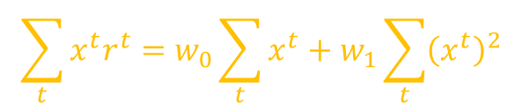
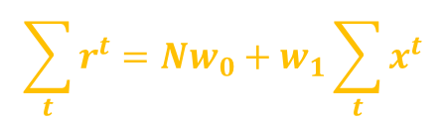
$$\begin{aligned}E\left(θ | X\right)=\frac{1}{2}\sum_{t=1}^{N}{{\left[r^{t}−g\left(x^{t} | θ\right)\right]}^{2}}\#\end{aligned}$$
Least Square Estimate: It is mostly used error function in regression
When the likelihood l contains exponents, instead of maximizing l, we define an error function, $E = − logl$, and minimize it
Linear Regression Model
$g\left(x^{t} | w_{1}, w_{0}\right)= w_{1}x^{t} + w_{0}$
By taking derivative of sum of squared errors eq. w.r.t $w_{1}$ and $w_{0}$
Derivation w.r.t. $w_{0}$, we get
Derivation w.r.t. $w_{1}$, we get
$$E\left(θ | X\right)=\frac{1}{2}\sum_{t=1}^{N}{{\left[r^{t}−g\left(x^{t} | θ\right)\right]}^{2}}$$
$$=\frac{1}{2}\sum_{t=1}^{N}{{\left[r^{t}−\left(w_{1}x^{t}+w_{0}\right)\right]}^{2}}$$
$$\sum_{t}{r^{t}=Nw_{0}+w_{1}\sum_{t}{x^{t}}}$$
$$\sum_{t}{x^{t}r^{t}=w_{0}\sum_{t}{x^{t}}}+w_{1}\sum_{t}{{\left(x^{t}\right)}^{2}}$$

Slide 9

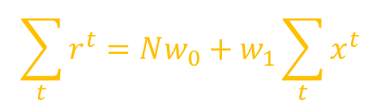
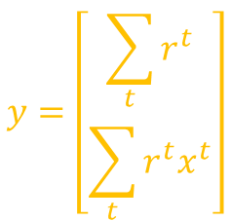


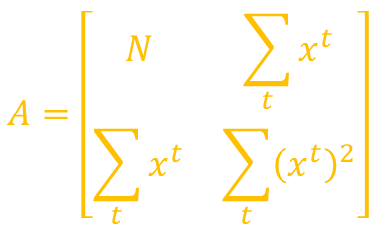

There are two equations with two unknowns
Equations can be written in vector-matrix form as $Aw = y$ where
$$\sum_{t}{r^{t}=Nw_{0}+w_{1}\sum_{t}{x^{t}}}$$
$$\sum_{t}{x^{t}r^{t}=w_{0}\sum_{t}{x^{t}}}+w_{1}\sum_{t}{{\left(x^{t}\right)}^{2}}$$
$$A=\left[\begin{matrix}N & \sum_{t}{x^{t}} \\ \sum_{t}{x^{t}} & \sum_{t}{{\left(x^{t}\right)}^{2}}\end{matrix}\right]$$
$$y=\left[\begin{matrix}\sum_{t}{r^{t}} \\ \sum_{t}{r^{t}x^{t}}\end{matrix}\right]$$
$$w=\left[\begin{matrix}w_{0} \\ w_{1}\end{matrix}\right]$$
And can be solved using $w =A^{−1}y$

Slide 10




For general case of polynomial regression
$g\left(x^{t} | w_{k}, . . . , w_{2}, w_{1}, w_{0}\right)= w_{k}{\left(x^{t}\right)}^{k} + · · · + w_{2}{\left(x^{t}\right)}^{2}+w_{1}x^{t}+w_{0}$
There are $k+1$ equations with $k+1$ unknowns
$$A=\left[\begin{matrix}N & \sum{x^{t}} & \sum{{\left(x^{t}\right)}^{2}} & … & \sum{{\left(x^{t}\right)}^{k}} \\ \sum{x^{t}} & \sum{{\left(x^{t}\right)}^{2}} & \sum{{\left(x^{t}\right)}^{3}} & … & \sum{{\left(x^{t}\right)}^{k+1}} \\ \sum{{\left(x^{t}\right)}^{2}} & ⋯ & ⋯ & ⋯ & ⋮ \\ … & ⋮ & ⋮ & ⋮ & ⋮ \\ \sum{{\left(x^{t}\right)}^{k}} & \sum{{\left(x^{t}\right)}^{k+1}} & \sum{{\left(x^{t}\right)}^{k+2}} & … & \sum{{\left(x^{t}\right)}^{2k}}\end{matrix}\right]$$
$$y=\left[\begin{matrix}\sum{r^{t}} \\ \sum{r^{t}}x^{t} \\ \sum{r^{t}}{\left(x^{t}\right)}^{2} \\ … \\ \sum{r^{t}}{\left(x^{t}\right)}^{k}\end{matrix}\right]$$
$$w=\left[\begin{matrix}w_{0} \\ w_{1} \\ w_{2} \\ … \\ w_{k}\end{matrix}\right]$$

Slide 11



Cholesky Decomposition of Matrices
We can write $A = {DD}^{T}$and $y = D^{T}r$where
This could be solved as $w=A^{−1}y={\left(D^{T}D\right)}^{−1}D^{T}r$
$$D=\left[\begin{matrix}1 & {\left(x^{1}\right)}^{1} & {\left(x^{1}\right)}^{2} & ⋯ & {\left(x^{1}\right)}^{k} \\ 1 & {\left(x^{2}\right)}^{1} & {\left(x^{2}\right)}^{2} & ⋯ & {\left(x^{2}\right)}^{k} \\ 1 & {\left(x^{3}\right)}^{1} & {\left(x^{3}\right)}^{2} & ⋯ & {\left(x^{3}\right)}^{k} \\ ⋮ & ⋮ & ⋮ & ⋮ & ⋮ \\ 1 & {\left(x^{N}\right)}^{1} & {\left(x^{N}\right)}^{2} & ⋯ & {\left(x^{N}\right)}^{k}\end{matrix}\right]$$
$$r^{t}=\left[\begin{matrix}\begin{aligned}r^{1} \\ r^{2} \\ r^{3} \\ ⋮ \\ r^{N}\end{aligned}\end{matrix}\right]$$

Slide 12


Assuming Gaussian distributed error and maximizing likelihood corresponds to minimizing the sum of squared errors
Other error measures
Relative square error (RSE):
If $E_{RSE}→1$: prediction is as good as predicting by average. Input x has least effect
If $E_{RSE}→$0: We have better fit. Input x has better effect
Coefficient of Determination
A measure to check the goodness of fit by regression
$R^{2}=1−E_{RSE}$
A good regression generates $R^{2}$ close to 1
$$E_{RSE}=\frac{\sum{{\left[r^{t}−g\left(x^{t} | θ\right)\right]}^{2}}}{{\left(\sum{r^{t}−mean(r)}\right)}^{2}}$$

Slide 13
4.7 Tuning Model Complexity

Slide 14
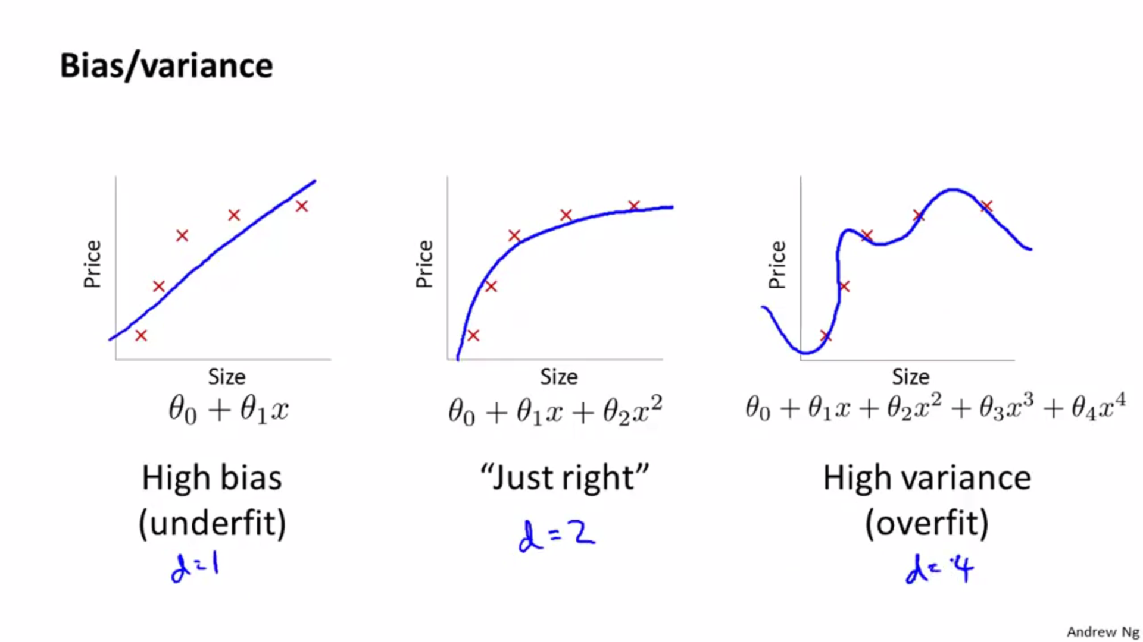

Slide 15
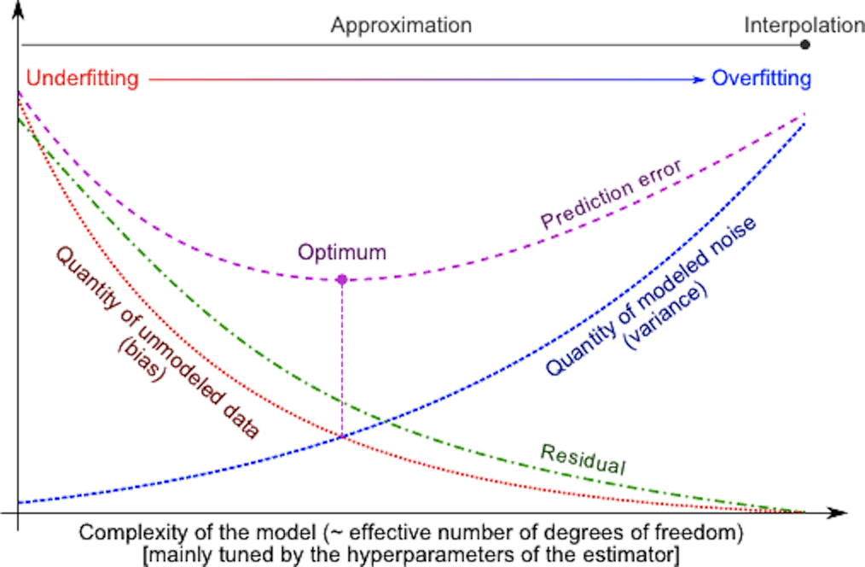

Slide 16

Tuning Model Complexity: Bias/Variance Dilemma
Let $X={\left\{x^{t},r^{t}\right\}}_{t=1}^{N}$, sample from some unknown joint distribution $p(x,r)$
Using this sample, we construct our estimate $g(.)$
Error in our model is
$E[r|x]$ the average of real value for given sample
1st term is the variance of r given x (noise). This part of error can never be removed, how good estimator is used as it does not depend upon g(.)
2nd term (squared error) quantifies the deviation of g(x) from regression function
$$\begin{aligned}E\left[{\left(r−g\left(x\right)\right)}^{2} | X\right]=E\left[{\left(r−E\left[r | x\right]\right)}^{2} | x\right]+{\left(E\left[r | x\right]−g\left(x\right)\right)]}^{2}\#\end{aligned}$$

Slide 17
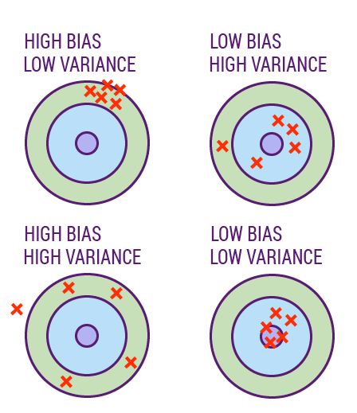
Bias/Variance
$$E_{X}\left[{\left(E\left[r | X\right]−g\left(x\right)\right)}^{2} | X\right]={\left(E\left[r | X\right]−E_{X}\left[g\left(X\right)\right]\right)}^{2}+E_{X}[{\left(g\left(X\right)−E_{X}\left[g\left(X\right)\right]\right)}^{2}]$$
First term is bias and second is variance
Bias: it tells that how much our estimate g(x) is wrong from actual value (mean in this case)
Variance: how much estimate varies around the mean value
We want both be small

Slide 18
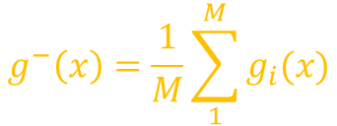


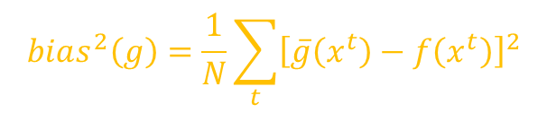
Example: Bias/Variance
Let we have a sample sets from some known distribution with some noise
Find $g_{i}(x)$ for each dataset and find variance and bias
In real life, exact distribution of data is not known
Estimate $E[g(x)]$by averaging over $g_{i}\left(x\right)$
Estimated bias and variance are
$$g^{−}\left(x\right)=\frac{1}{M}\sum_{1}^{M}{g_{i}(x)}$$
$$bias^{2}\left(g\right)=\frac{1}{N}\sum_{t}{{\left[\overline{g}\left(x^{t}\right)−f\left(x^{t}\right)\right]}^{2}}$$
$$Variance\left(g\right)=\frac{1}{NM}\sum_{t}{\sum_{i}{{\left[g_{i}\left(x^{t}\right)−\overline{g}\left(x^{t}\right)\right]}^{2}]}}$$

Slide 19
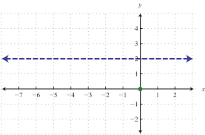
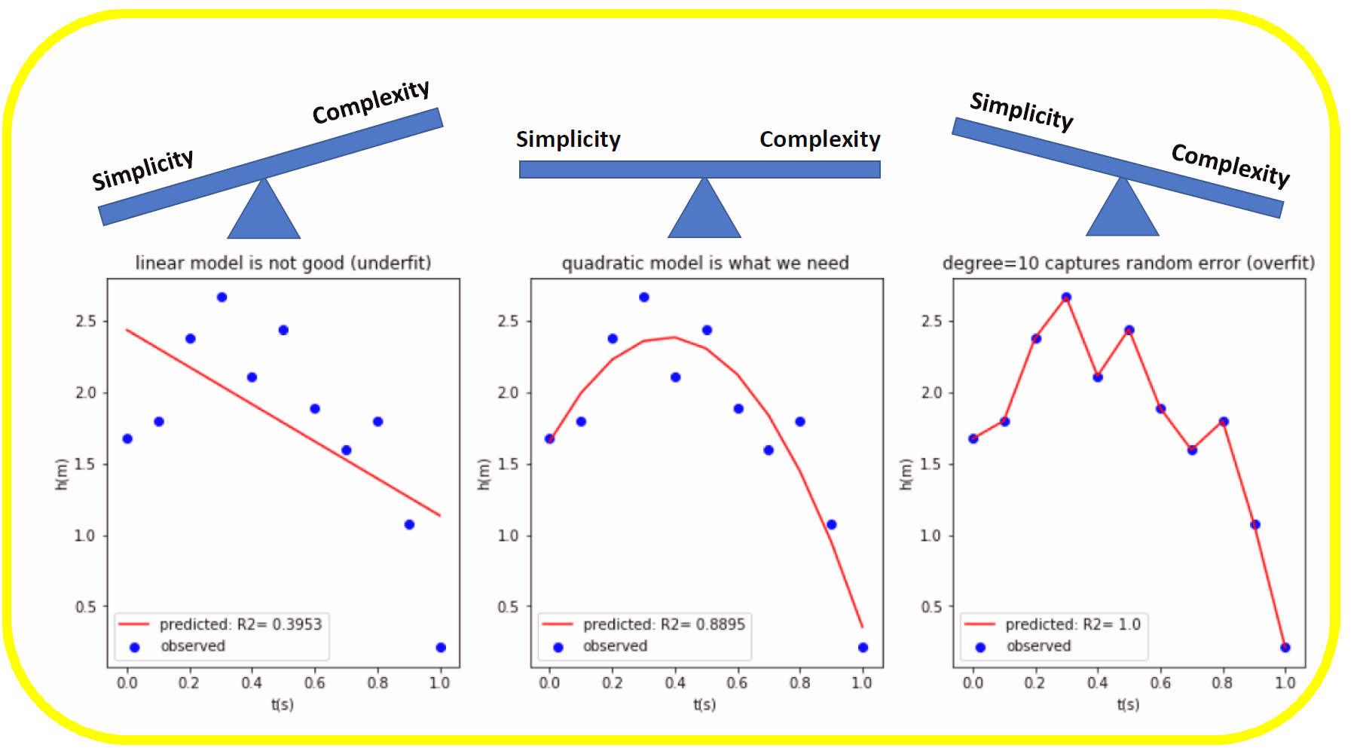
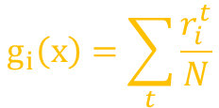

Models with varying complexity
The simplest is a constant fit i.e. $g_{i}\left(x\right)=2$
Variance: No variance as for all data, the estimate is same
Bias: It is high, unless actual value $f(x)$ is close to 2
Take the average of $r^{t}$ in sample instead of 2. In general, average is better estimate
But this increases the variance because the different samples $X_{i}$ would have different average values.
Normally in this case the decrease in bias would be larger than the increase in variance, and error would decrease.
$$g_{i}\left(x\right)=\sum_{t}{\frac{r_{i}^{t}}{N}}$$

Slide 20
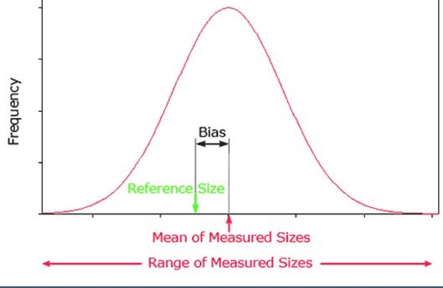
Bias/Variance in Polynomial Regression
Variance:
It increases as the order of the polynomial increases, small changes in the dataset cause a greater change in the fitted polynomials
Bias:
It decreases as a complex model on the average allows a better fit to the underlying function
To decrease bias, the model should be flexible, at the risk of having high variance
If the variance is kept low, we may not be able to make a good fit to data and have high bias
The optimal model is the one that has the best trade-off between the bias and the variance

Slide 21
Presence of bias shows that our model does not contain the solution
It is underfit
Presence of variance, the model class is overfitting too general and also learns the noise
It is overfit
If g(x) and f(x) belong to same distribution
Unbiased estimator:
This shows error-reducing effect of choosing the right model known as inductive bias
Low variance: the variability decreases
In short, to minimize the error
Model should have proper inductive bias (small bias)
There should be large enough dataset to constrain the variability of data

Slide 22
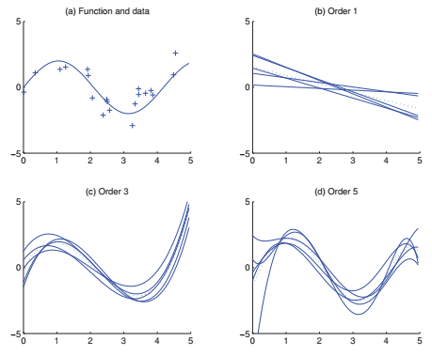

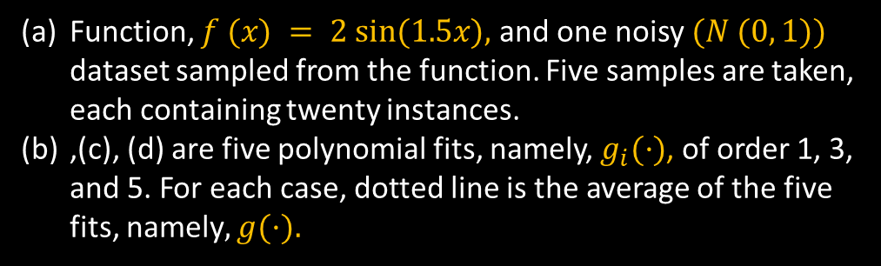
when the variance is large, bias is low showing that $\overline{g}\left(x\right)$ is good estimator
To get a small value of error, we can take a large number of high-variance models and use their average as our estimator.
Function, $f (x) = 2 sin⁡(1.5x),$and one noisy $(N (0, 1))$ dataset sampled from the function. Five samples are taken, each containing twenty instances.
,(c), (d) are five polynomial fits, namely, $g_{i}(·)$, of order 1, 3, and 5. For each case, dotted line is the average of the five fits, namely$, g(·).$

Slide 23



Thanks for watching
Dr. Sajid Iqbal
Assistant Professor
Department of Computer Science
Bahauddin Zakariya University, Multan
sajidiqbal.pk@gmail.com
https://github.com/sajjo79/Design_and_Analysis_of_Algorithms
Allah Hafiz
COMEDXD

Slide 24
Assignments

